Slide 1
CSS Grid

Slide 2
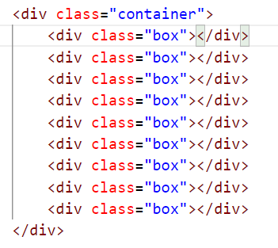
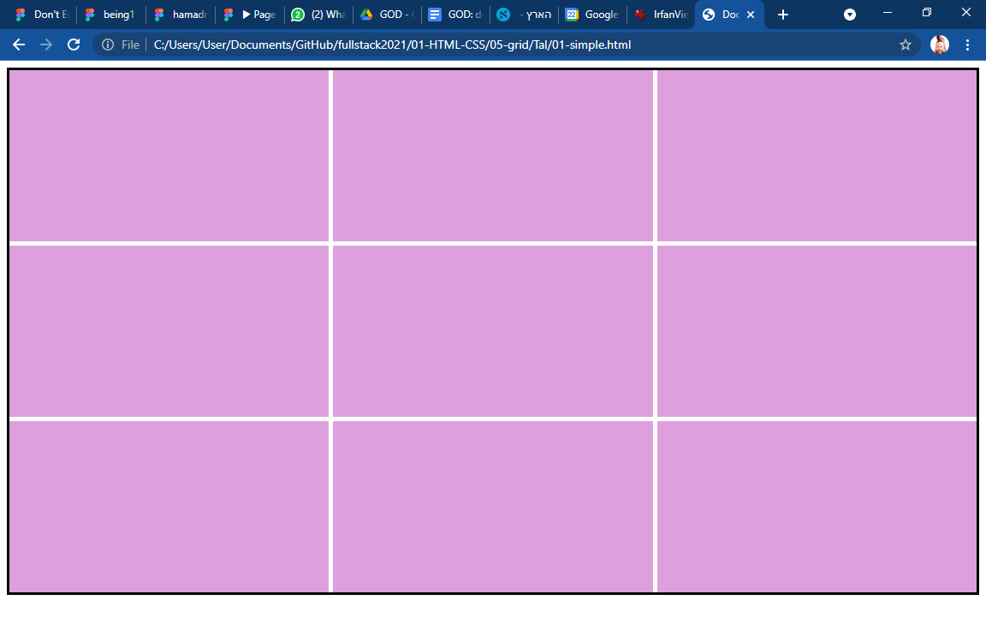
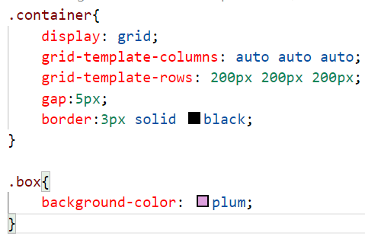
Css grid layout (01-simple.html)

Slide 3
Css grid layout (01-simple.html)
Like in flex, you have to wrap the cells in a container

Slide 4
Css grid Css grid layout (01-simple.html)
Like in flex, you have to wrap the cells in a container
Like in flex, you have to wrap the cells in a container

Slide 5
Css grid layout (01-simple.html)
Grid-template-columns: the number of values set the number of columns. Every value is the width of the column

Slide 6
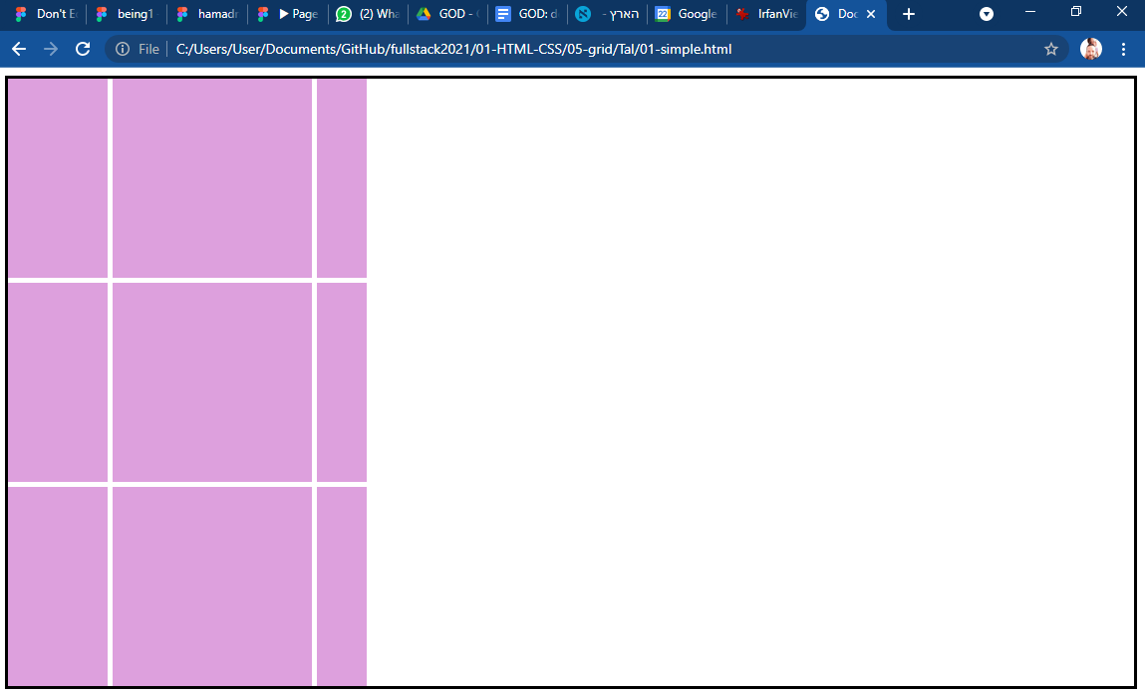
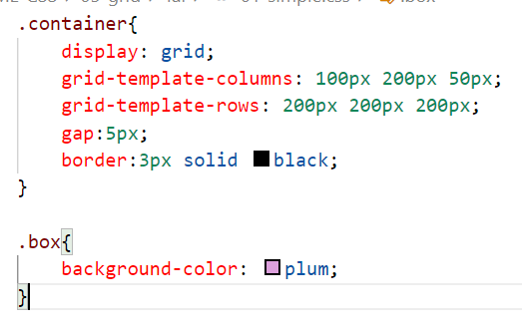
Css grid layout (01-simple.html)
Grid-template-columns: the number of values set the number of columns. Every value is the width of the column

Slide 7
Css grid layout (01-simple.html)
Grid-template-rows: the number of values set the number of rows. Every value is the height of the column

Slide 8
Css grid layout (01-simple.html)
gap: set the size of the gaps between the boxes

